Slide 1
Analytical Lab Project
CARS IN GERMANY
Group A:
Assylbek Bugybay
Sevde Yanik
Aleksandra Pasheva
Anna Campi
Rami Bader

Slide 2

CONTENT
How the data was obtained.
How did we build database and what analysis was done.
Results we got.

Slide 3

PURPOSE:
By analysing data of Autoscout in Germany, we investigate evolving demands of car features throughout the years.
We want to give the business person a good perspective of how customer preferences change throughout time in order to maximize profits.
Our business person needs information about the most popular brands, fuels, and the preferred amount of money German drivers are willing to spend if they want their business to takeoff.

Slide 4



TOOLS USED:
MySQL Workbench – we created the Snowflake schema with forwards engineering and solved queries in order to find information and make analysis.
Knime for Data Insertion.
Excel – we created Pivot tables and charts in order to visualize our results.

Slide 5


ABOUT THE DATA:
Data was obtained from Kaggle data Science community;
Data shows cars in AutoScout24 car market. AutoScout24 is the online vehicle market, for the purchase and sale of all types of vehicle;
Dataset represents collection of data from 2011 to 2021.
Each row represents a separate car purchase.
Columns show the car model, price, type of fuel and transmission, the year of production, the horse power and producer of the car.

Slide 6
SNOWFLAKE SCHEMA
Necessary steps to produce the schema:
Modelling the ER model in MySQl Workbench.
Dimension Tables as Make, Model, Time, Gear, Fuel and Horse_Power were created first.
After we had Dimension tables we created our Fact table, which includes data columns as well as foreign keys of Dimension tables.
Foreign keys are created automatically, while configuring Relation types between tables.
After having ER model we used Forward Engineering to automatically generate sql queries to produce tables and set Relation Types.

Slide 7
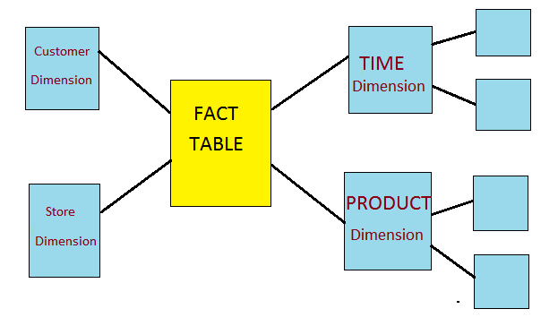
CHARACTERISTICS OF THE SNOWFLAKE SCHEMA:
Data Split into different Dimension Tables.
Hierarchies are divided into separate tables.
One fact table surrounded by dimension table which are in turn surrounded by other dimension tables
It is normalized Data Structure.
The centralized fact table is connected with multiple dimensions. The fact table holds the main data. It includes a large amount of aggregated data.

Slide 8
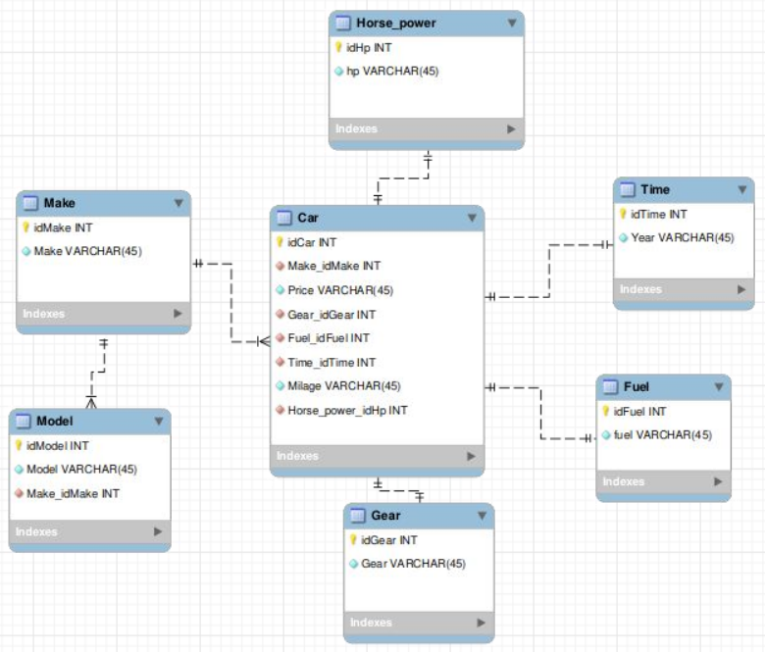
FINAL SCHEMA PRODUCED:

Slide 9

PURPOSE OF SNOWFLAKE SCHEMA:
It makes easier to implement, further dimensions. They are simply added to the Schema.
Data is more structured.
Better to storing data.

Slide 10
DATA MART SCHEMA
Necessary steps to produce the schema:
The Data Mart schema was derived from the Snowflake schema by joining sub-dimensions.
New schema was created using SQL queries.
Snowflake schema was copied into the new Database using PHP My Admin.
In our case Model table with the Make table was joined.

Slide 11
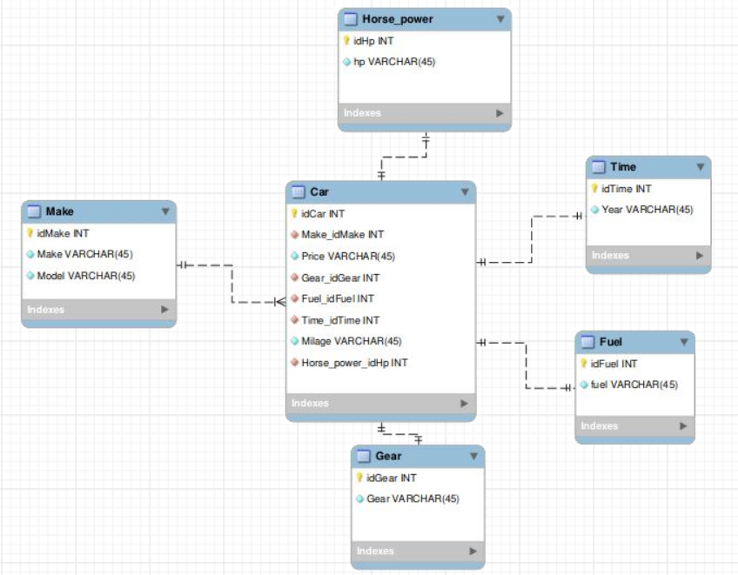
DATA MART SCHEMA

Slide 12
PURPOSE OF DATA MART SCHEMA:
Fewer joins are needed when writing queries.
Makes analysis much easier.
Takes less space to store dimension tables, but it has more data, so that can be difficult to maintain.

Slide 13
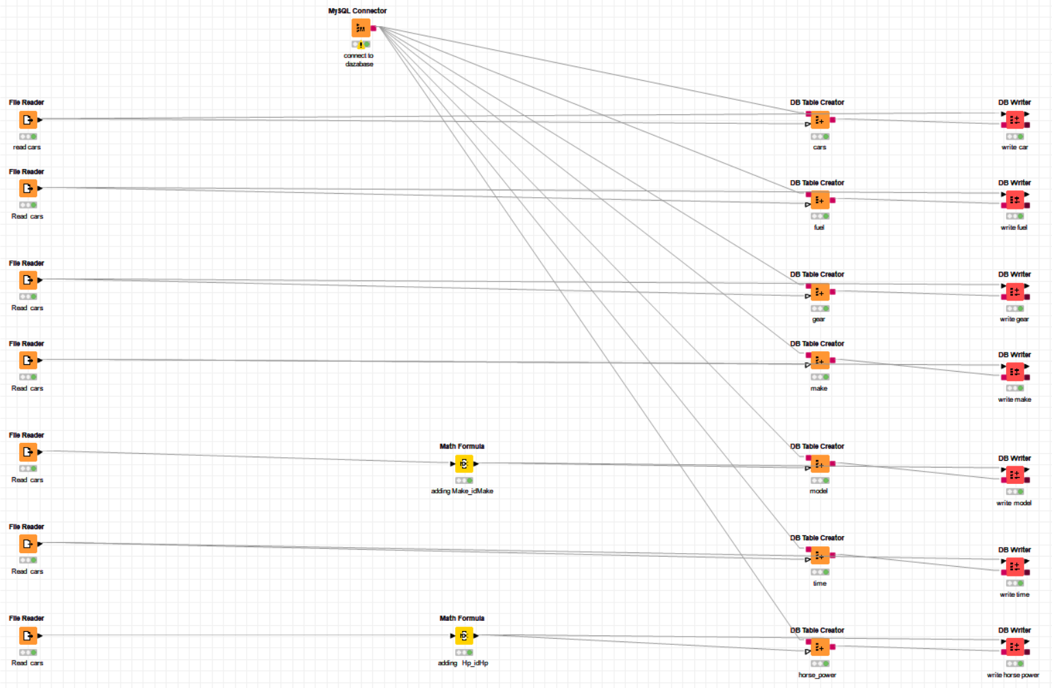
Data insertion with Knime
Workflow:

Slide 14
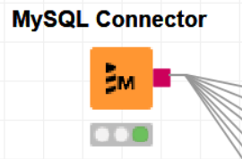
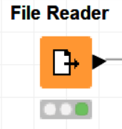
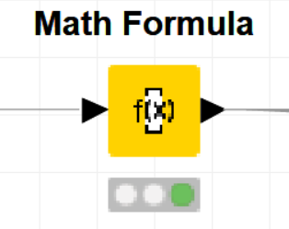
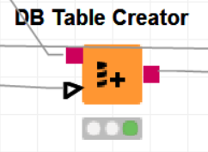
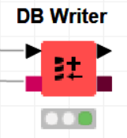
Data insertion with Knime
Used nodes:

Slide 15

DATA ANALYSIS
Since the data analysis is a process of inspection, transforming, and modeling the data with the goal of discovering useful information we created questions in the following categories in order to make conclusions about the database:
Environmental companies offering electric cars, registered vehicles, etc.
Customer demands most desired HP through the production years, most popular car models, etc.
Money most expensive car, average price for different type of cars, etc.

Slide 16
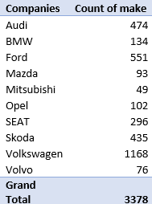
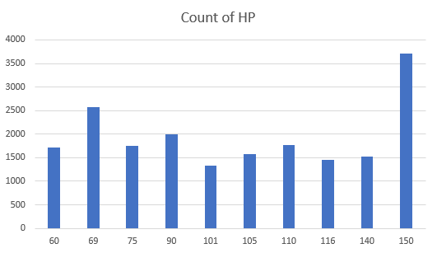
What is the most desired HP by German drivers? Which companies offer this level of HP?

Slide 17
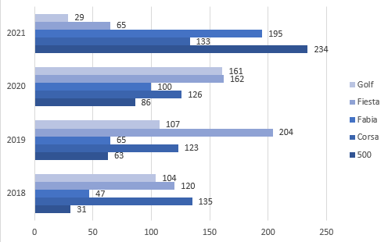
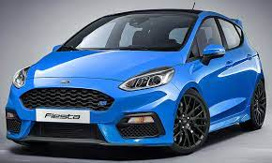
Which are the most popular car models according to the years the cars were produced?

Slide 18
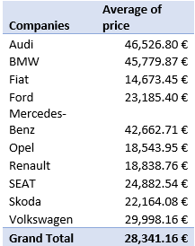
What are the average prices of cars produced in 2020?
SELECT DISTINCT ma.make, t.year, COUNT(ma.make) oc,
ROUND(AVG(Price)) avarage_price
FROM makes ma
LEFT JOIN cars c ON ma.Make_idMake = c.Make_idMake
LEFT JOIN times t ON c.Time_idTime = t.Time_idTime
WHERE t.year = 2020
GROUP BY ma.make, t.year;

Slide 19
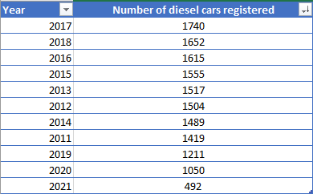
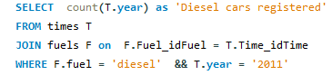
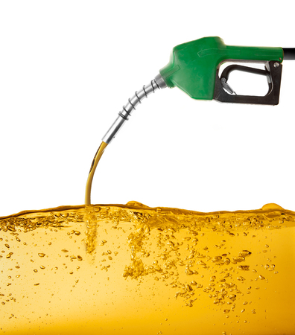
When were most diesel cars registered? When were least?
The concept of this solution was created using sql query for calculations of each year’s registration of diesel cars. After gathering all the information needed, the following Excel table was created:

Slide 20
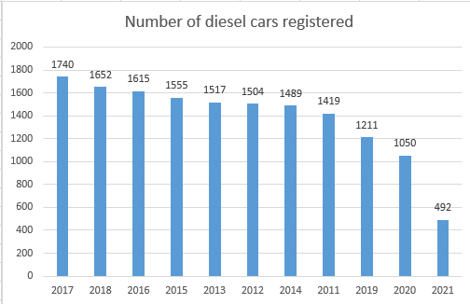

When were most diesel cars registered? When were least?
After the sorted table was created, the following chart visualizes all the important information:

Slide 21

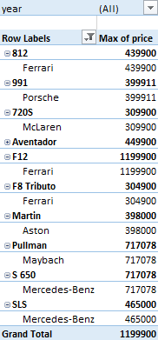
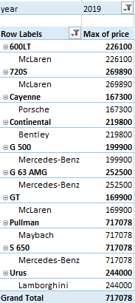
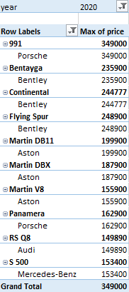
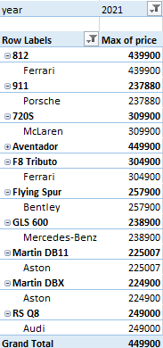
Which is the most expensive car
registered per year?
The concept of the solution was created using a pivot table in Excel.

Slide 22
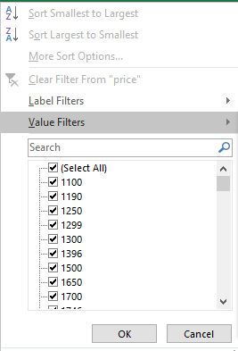
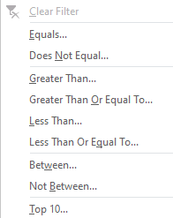

Which is the most expensive car registered per year?
Explanation of the pivot table:
Filters: year
Rows: model, make
Values: Max of price:
The shown result is filtered,
so only top 10 models appear

Slide 23
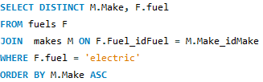
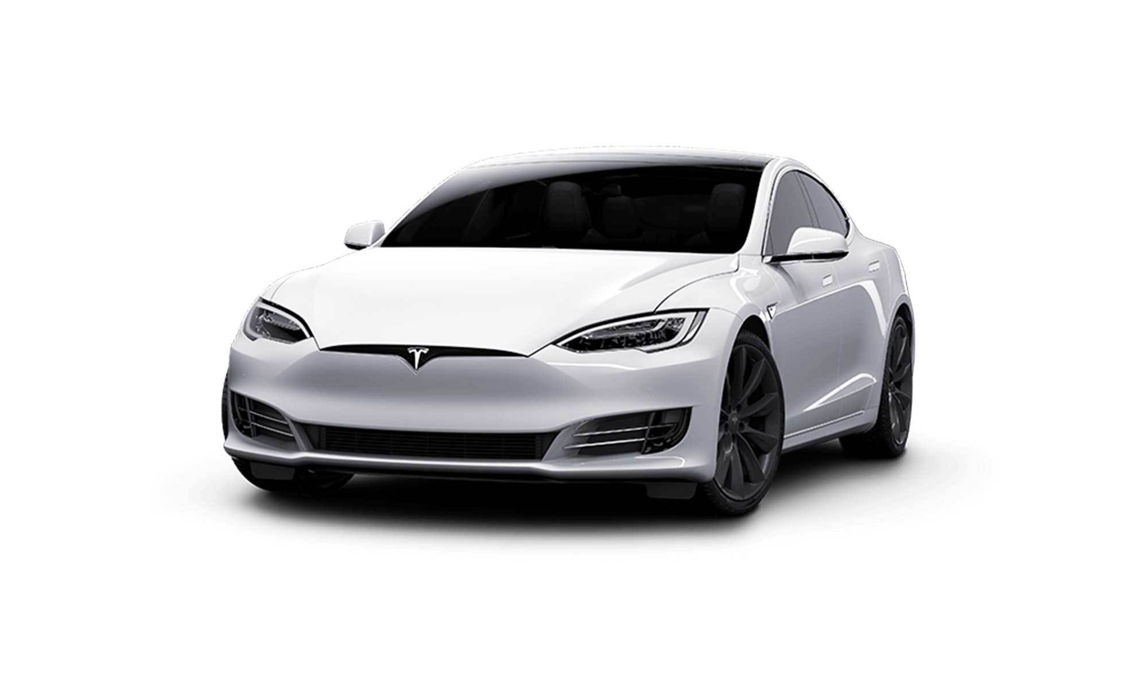
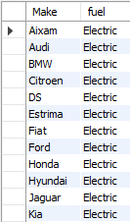
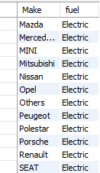


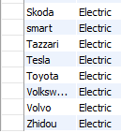
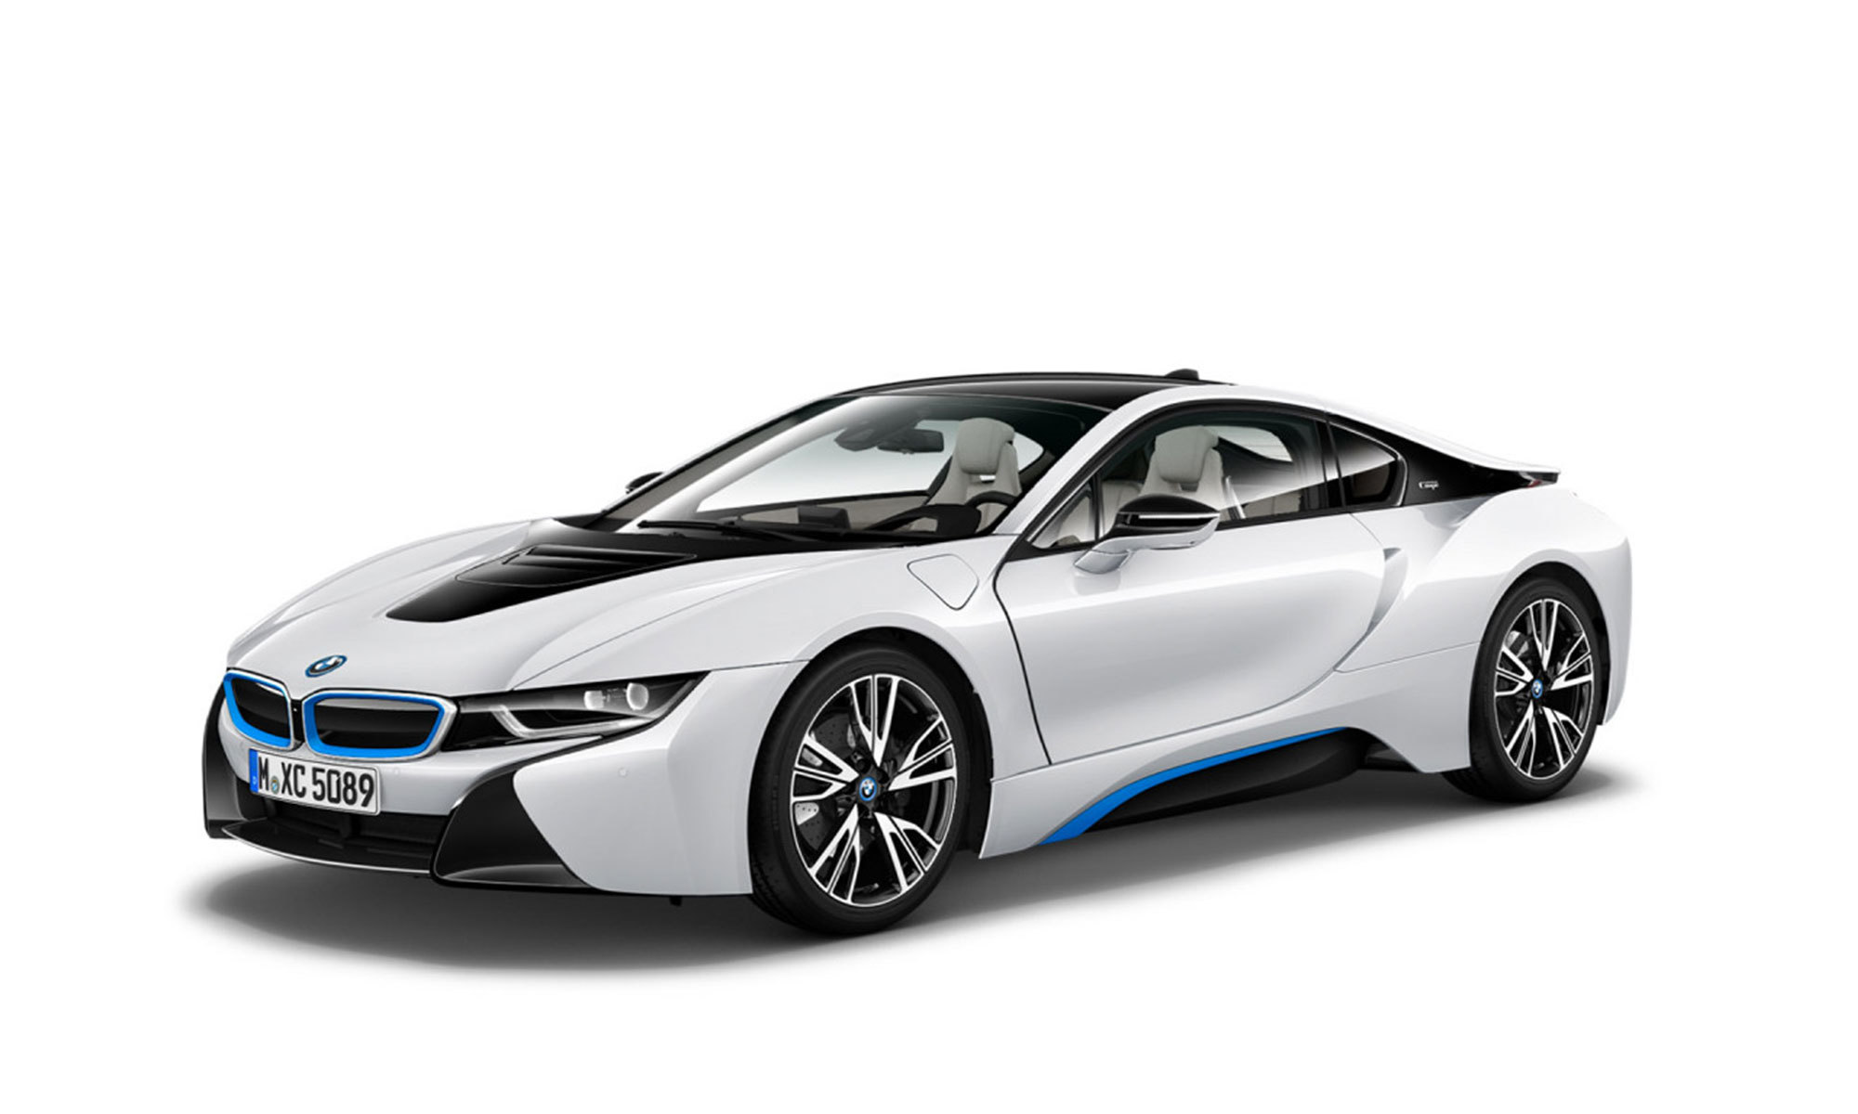
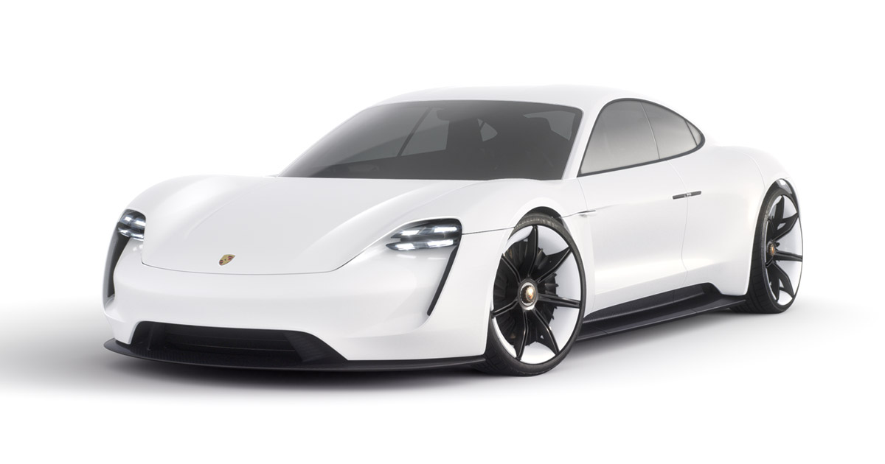
Which companies produce electric cars?
The concept for this solution was created using the following SQL query:
The result is:

Slide 24
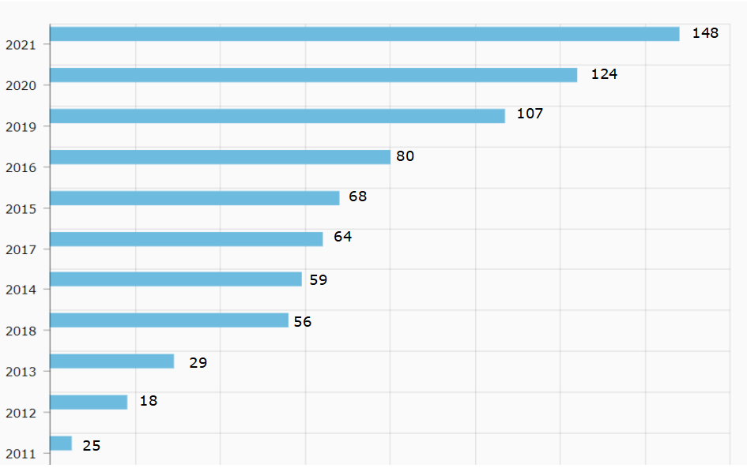
In which years were most electric cars registered?
The following chart allows us to observe the incremental growth of sales of electric cars through the years.

Slide 25
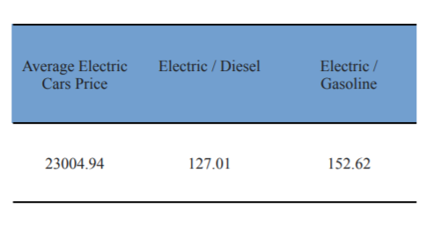
What is the average price for electric cars? How does it compare to gasoline/diesel cars?
Electric cars average price is 27% higher than the average Diesel car price and 52% higher than the average Gasoline car price.

Slide 26
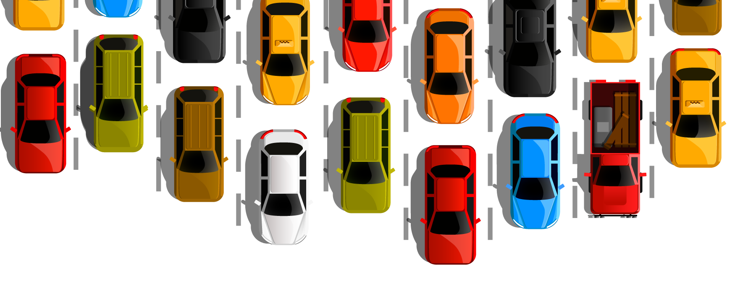
CONCLUSION
With the results provided, we hope we gave to future car dealers all the understanding they need for opening a successful car business. Even those who are simply willing to get a new car also can have a better understanding of the car market.

Slide 27

ANY QUESTIONS? IF NOT, WE:

